Slide 1


Opening Remarks for the Template Workshop
Office of Vehicle Safety Compliance (OVSC)
Fuel Efficiency Group
07.12. 2022

Slide 2

Table of Contents
CAFE Projection Reporting Template – Slide 3
Credit Transaction Template – Slide 14
PIC Website – Slide 30
Credit Trade Value Template – Slide 43
CAFE 101 – Slide 51

Slide 3
MY 2023 CAFE Projection Reporting Template
Office of Vehicle Safety Compliance (OVSC)
Fuel Efficiency Group
07.12. 2022

Slide 4

Template Purpose
1
AGENDA
2
Final Requirements
3
Template Structure
4

Slide 5
Template Purpose
#
Addresses non-compliant PMY/MMY submissions
  Encourages complete data submissions
  Corrects inaccurate data
  Standardizes the data
Requires same data for PMY/MMY submissions
Uses same data as EPA final data
Will aide with audits and compliance testing
Will help identify potential compliance issues
Allows better projections of industry trends which we will use to shape new CAFE standards
Collects more detailed AC and OC data

Slide 6
Final Requirements
#
2018 NPRM introduced a new standardized template for PMY/MMY reports
Various improvements made to template in 2020 final rule
  Removed outdated data elements
  Extended effective date to MY 2023
  Added mapping to EPA’s data elements
  Auto calculation added wherever possible
Additional changes were made in response to 2021 NPRM Comments- errors corrected
  Improved alignment with 49 CFR part 537 and NHTSA rulemaking needs by introducing additional supporting data elements

Slide 7
How is the Projection Data Used by NHTSA?
  Supports NHTSA’s “Footprint” verification testing program at the San Angelo Testing Facility
  Used to generate internal/external reports
  Used for modeling that helps inform future rulemakings
  Informs agency decision-makers about upcoming CAFE issues (i.e., used to determine projected future credit balances and civil penalty amounts)

Slide 8
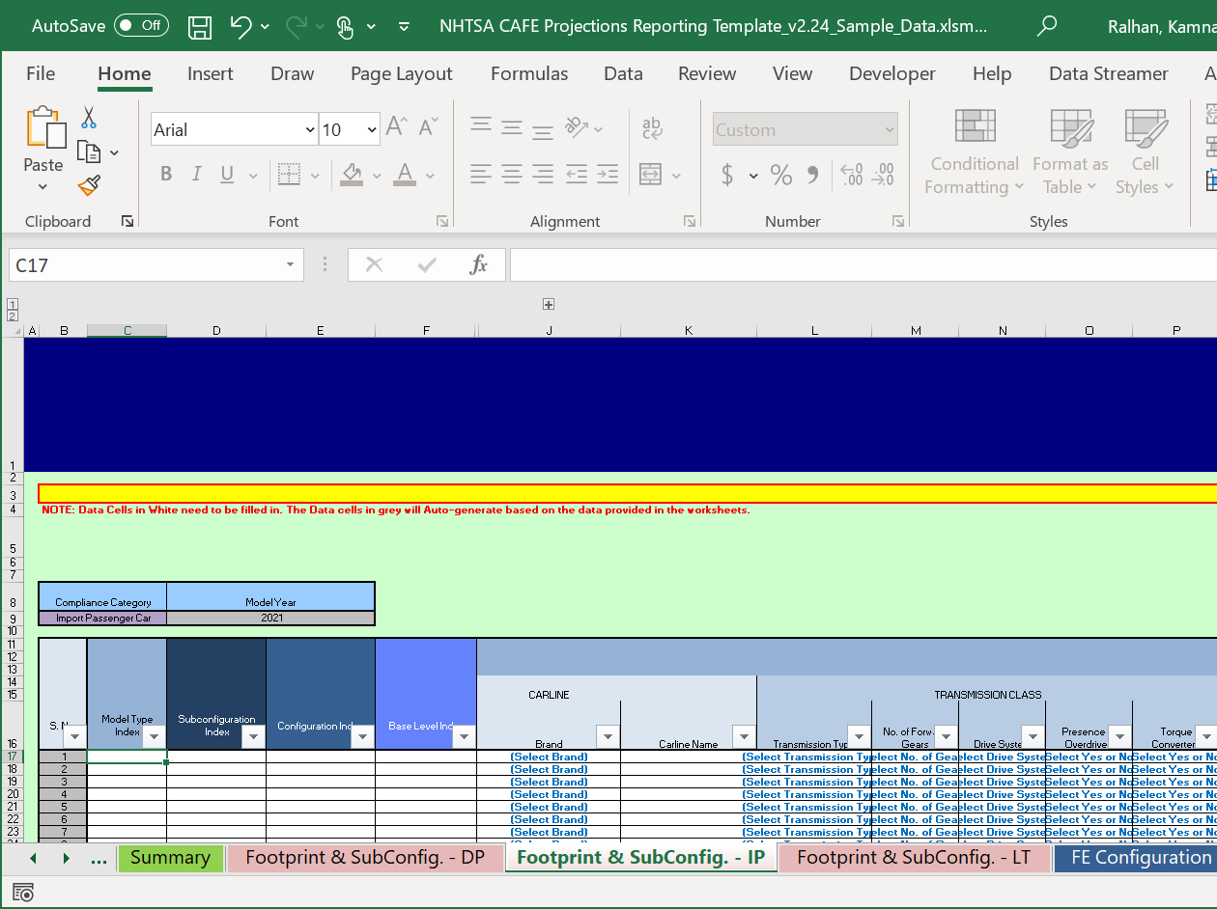
Template Structure
#
Tabs located along the bottom of the reporting template correspond to different elements of the OEM’s CAFE reporting; they include:
  Data Definitions
  General Info on POCs
  Calculations for Target and Fleet Standards
  Subconfiguration, Configuration and Base level Data
  Calculations for Model Type and Fleet Fuel Economy Values
  Vehicle Classification Data
  AC & OC Efficiency Data
Formulas and cross-tab-references are built into the template to validate reporting elements

Slide 9
Template Structure
    Manufacturers are only required to report information on vehicles that are available at the time each report is due.
    Manufacturers should use engineering judgment in estimating information where possible.
    By the end of the model year, all information on vehicles, fuel economy and incentives should be included in a CAFE report submitted NHTSA.
  All the reporting fields are necessary with exception for situations where the data field does not apply to a given fleet, model type, configuration, or sub-configuration. Data fields left blank on OEM reports later determined to be applicable data elements to a given fleet, model, configuration, or sub-configuration will be treated as a failure to report data and late reporting penalties can be levied.
  -white cells should be manually filled
  -grey cells will autogenerate

Slide 10
Light-Duty Definitions
#
*weights are in pounds
If there is production in 2 different ETW ranges, user must split the data and report the appropriate production for each of them.

Slide 11
Fuel Economy Calculations
#

Slide 12
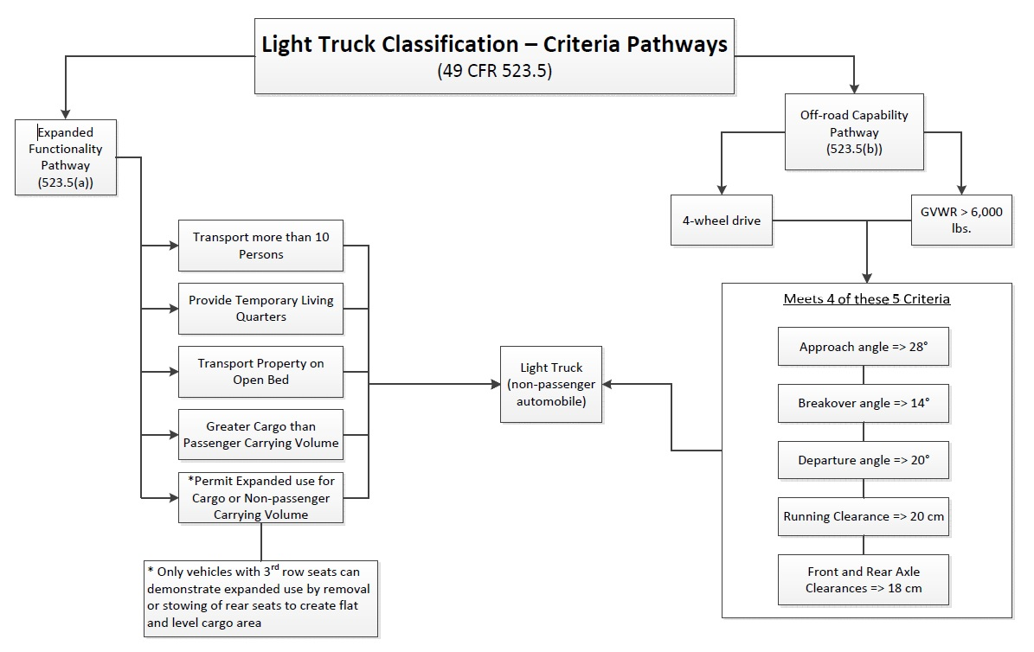
Vehicle Classification
#

Slide 13
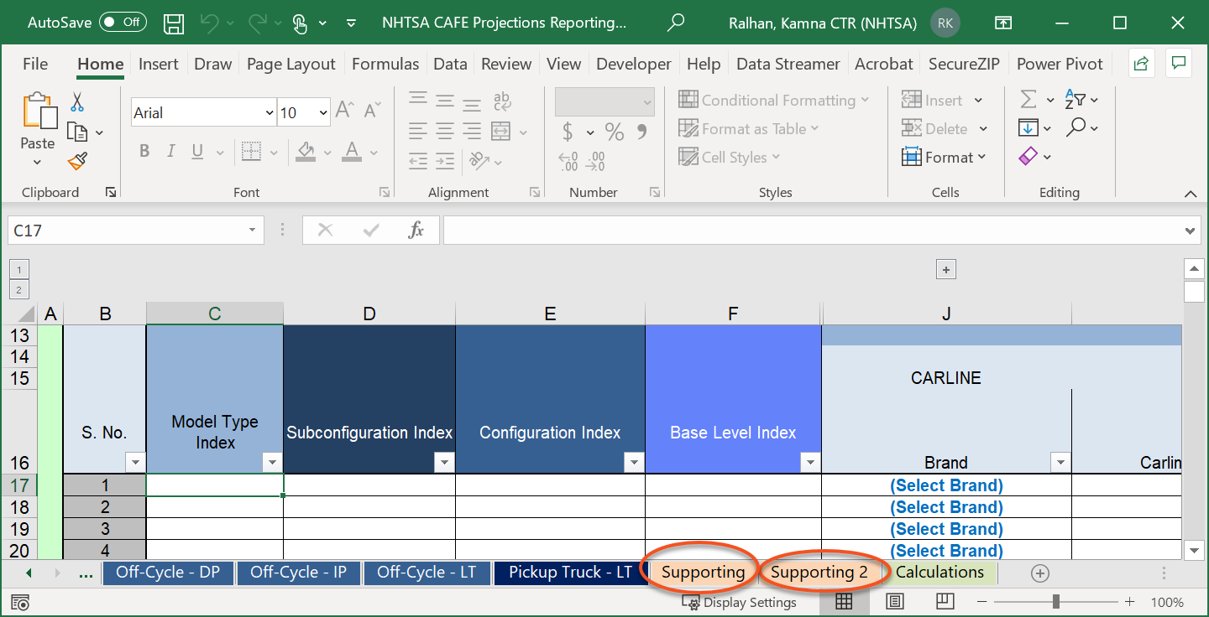

Support Tabs
#
#
The 2 supporting tabs include content related to the template function. These tabs are not intended to collect manufacturer data; OEMs should not modify or input any content on these tabs
  Terms and numerical values utilized in calculations throughout the report
  References for manufacturers
  Defines common acronyms

Slide 14
Credit Transaction Template
7.12.2022

Slide 15
1
Overview
2
Agenda
Where to find the Template
3
Instructions on how to fill out the template

Slide 16
Overview
Purpose:
Uniform data reporting for credit transactions
  Facilitates NHTSA processing credit transactions more efficiently
Calculates the adjustment factor per 49 CFR 536.4 (c)
  Prevents errors in the calculation and rounding
Any manufacturer submitting a credit transaction to NHTSA should use the credit transaction template
  For trades, buyer should fill out the template as discussed later
Date Required:
Mandatory reporting date is September 2022, according to CAFE Final Rule 2024-2026

Slide 17
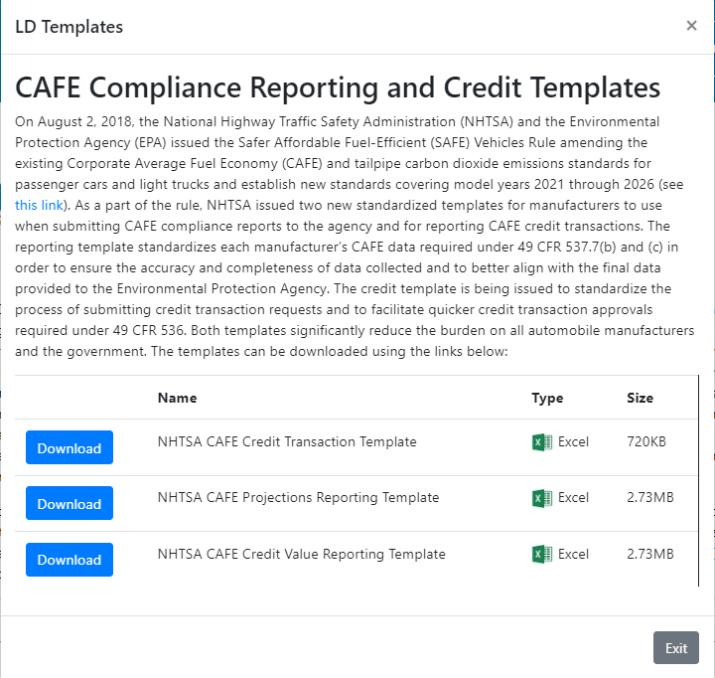
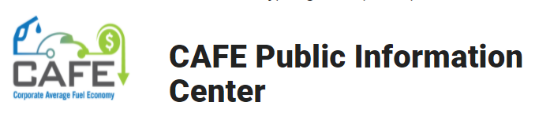
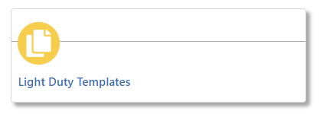
Where To Find the Template
https://one.nhtsa.gov/cafe_pic/CAFE_PIC_home.htm
User guide available at same location

Slide 18
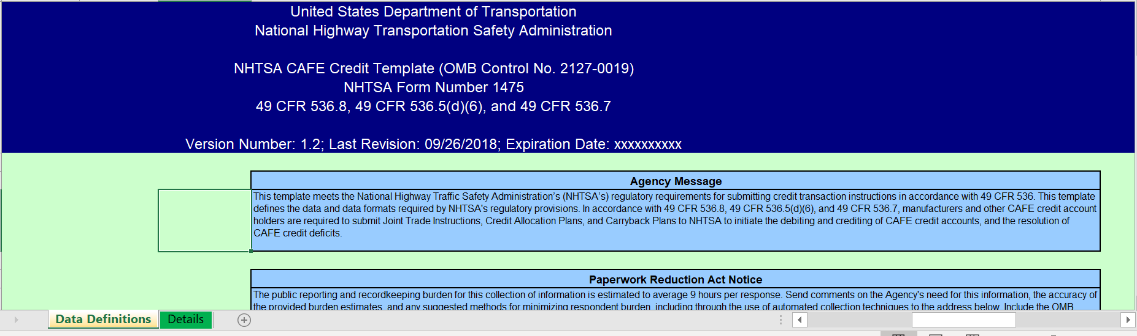
Instructions to fill out the template
Data Definitions Tab
This tab requires no information to be entered by the user.
  Provides information for the user to better understand where data should be entered in the Details and Transactions tabs
  Explains which regulations require this data

Slide 19
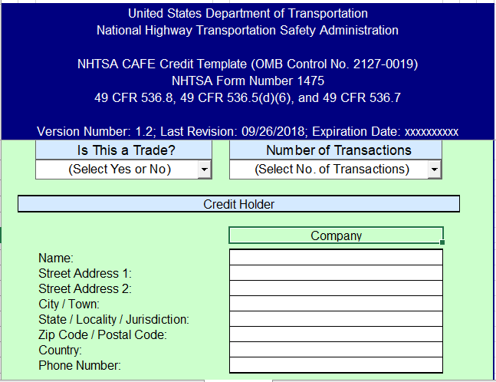
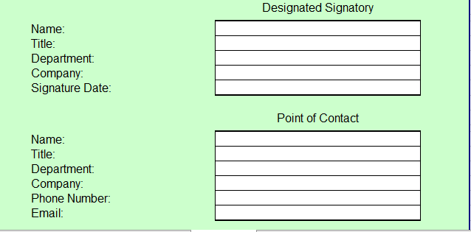
Details Tab
The user first selects if this credit transaction is a Trade
Next, the user selects the number of transactions
  can choose up to 10 transactions
  New transaction tabs will appear based on the number of transactions selected
fill out information regarding the credit holder:
  name, address, and phone number;
  designated signatory information including name, title, department, and company of the signatory and the signature date;
  point of contact information including the name, department, company, phone number, and email

Slide 20
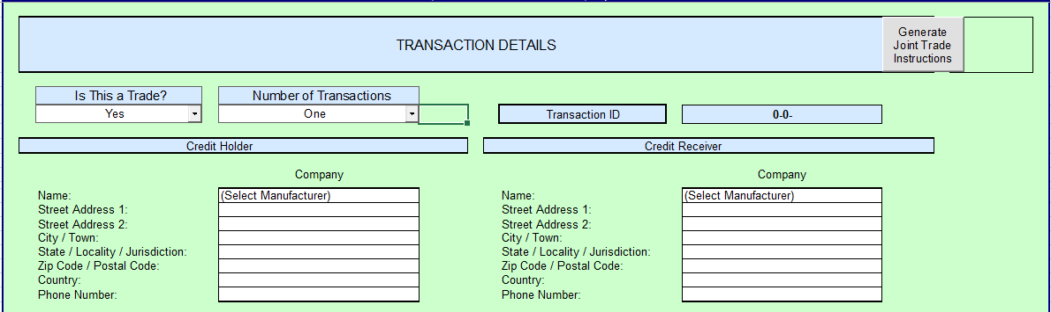
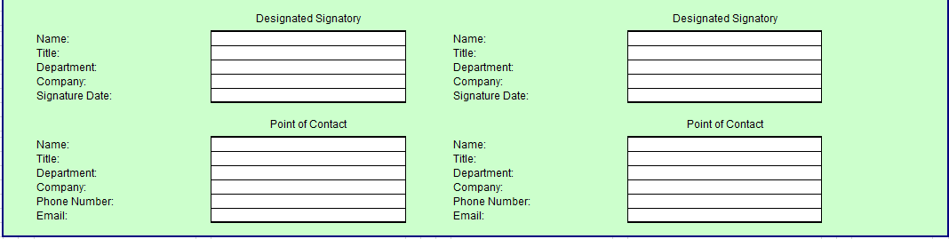
If the transaction is a trade, the Details page will widen, providing space to enter in information about the credit receiver.
The buyer should fill out the credit transaction template for both parties
An Unique Transaction ID will be auto generated
When done filling out the template, click the “Generate Joint Trade Instructions” to generate a pdf and obtain signatures from both credit trade parties
  include all the information from 536 that OEM needs to know for trading agreement and NHTSA requirement, and it creates acknowledgment for both party for sign

Slide 21
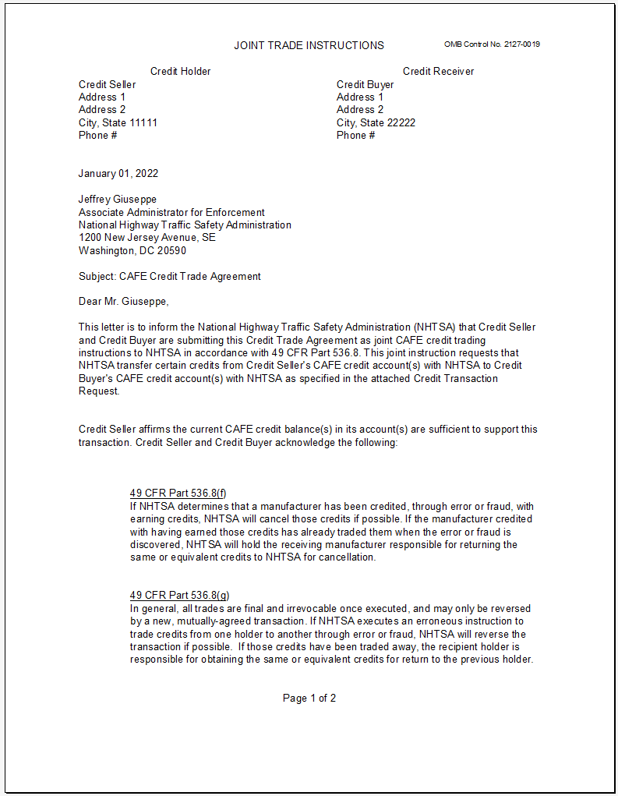
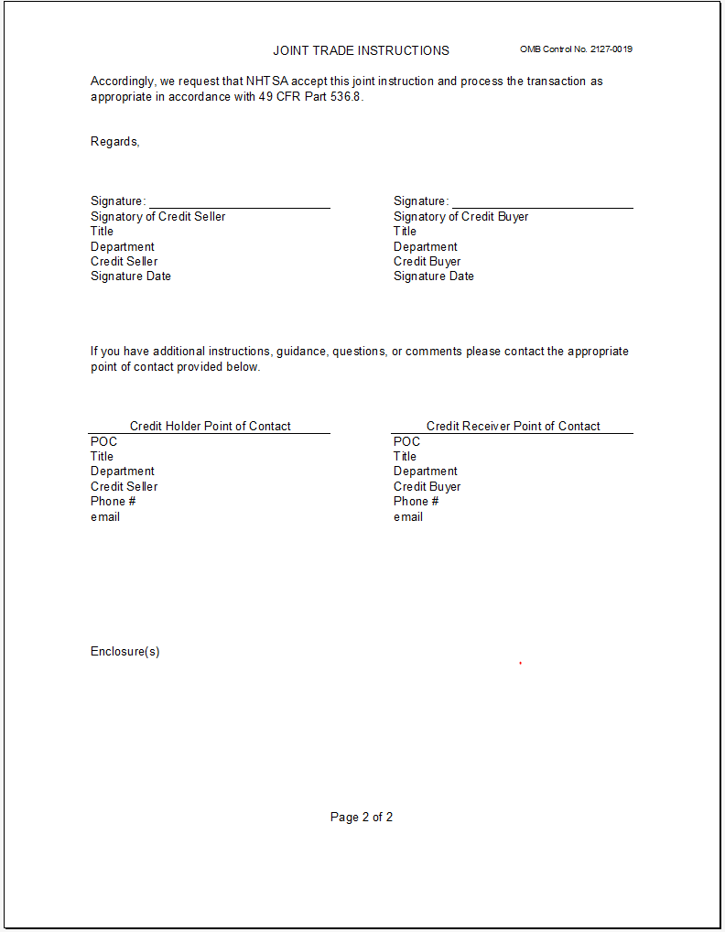
Anne Collins
Ms. Collins

Slide 22
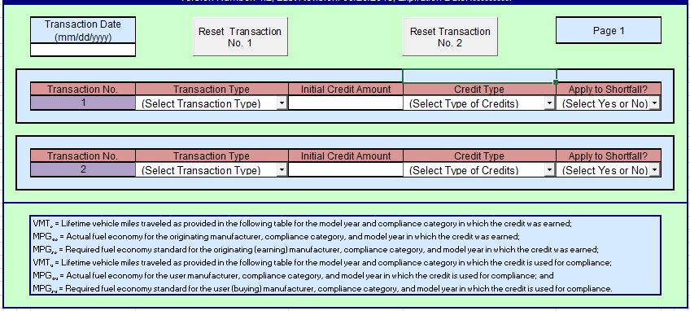
Transactions Tab
Transaction tabs show up based on the number of transactions selected in the Details tab.
Two transactions can be covered per Transaction tab.
The user must manually enter the date of the transaction for each transaction tab.
If the user makes a mistake, they can reset each transaction by clicking the Reset button.

Slide 23
Transactions Tab
For each transaction, the user first must select the type of transaction from the dropdown menu.
  Trade: Credits acquired by trading with another manufacturer
  Transfer: Credits transferred from other compliance fleets within the same manufacturer
  Carry Forward: Credits carried forward from previous MYs within the same compliance category
  Carry Back: Credits carried backward from future MYs within the same compliance category
  Application: Credits that have been banked are being applied to a shortfall
Types of Credits:
  Banked: Credits traded/transferred from another fleet or manufacturer and held until they are needed to resolve a shortfall
  Earned: Credits earned by a fleet for exceeding its CAFE standard

Slide 24
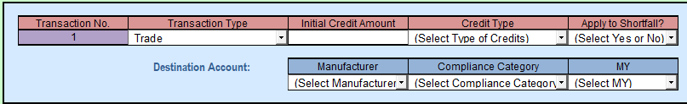
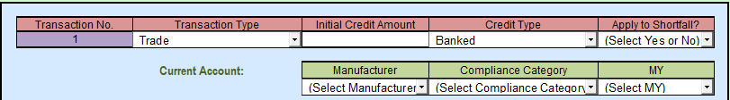
Trade/Transfer
Enter in the initial credit amount being traded or transferred and provide destination account information (Manufacturers, compliance category and MY)
Select Credit Type : Earned or Banked.
  Earned – No action needed
  Banked- Enter Current Account Information (where the credits are banked)
Select Yes/No to apply to a shortfall?
  No – Enter earned account information if the credit type is “Earned”(no addition info required if “Banked” is selected)

Slide 25
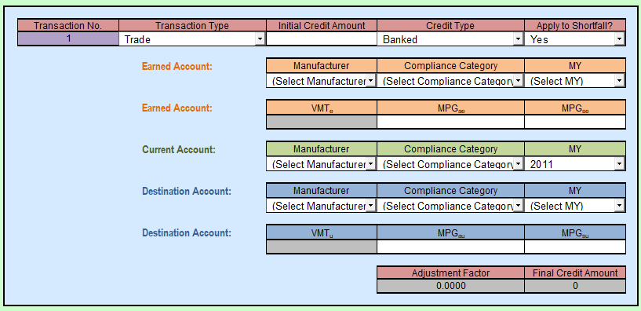
Select Yes/No for if these credits are being applied to a shortfall
    Enter account information for earned account
      Auto populate VMTe and VMTu value
    Enter MPGae (performance) and MPGse (standards) for both earned account and destination account
      The template will auto calculate the adjustment factor and final credit amount (after adjustment)
      For more info on the adjustment factor, please see the 49 CFR 536.4(c).

Slide 26
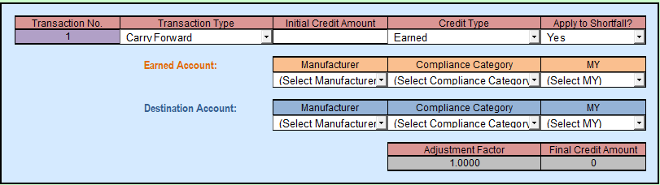
Carry Forward/Carry Backward
Once the user has selected carry forward/back:
  Credit type automatically populates to earned
  Apply to shortfall question is automatically switched to “Yes”
The user must manually enter:
  Initial credit amount
  Account information for both earned account and destination account

Slide 27
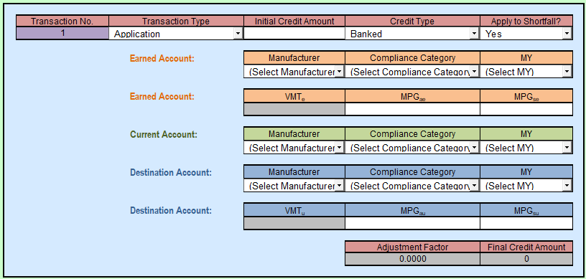
Application
Once the user has selected application
  Credit type automatically populates to banked
  Apply to shortfall question is automatically switched to “Yes”.
The user still must manually enter
  Initial credit amount
  Current account information
  Earned account and destination account information
    Auto populate VMTe/VMTu value
  MPGae (performance) and MPGse (standards) for both earned account and destination account
    Auto calculate the adjustment factor and final credit amount (after adjustment)

Slide 28

If this instruction contains TRADE:
Generate Joint Trade Instructions
Once all the necessary trade information is completed, return to the details tab.
Click ‘Generate Joint Trade Instructions.’
  generates the joint trade instructions for all the transactions entered in the workbook
make sure all the information is correct then can print a hard copy or print to PDF and obtain signatures

Slide 29
Credit Transactions in the Future
  The vision for the CAFE Database in the future will include a user interface for each OEM, allowing them to execute their own credit trades, visibility into their credit accounts in real time, and see pending credit transactions. This functionality will allow:
      Less time required for transaction approvals
      Increased transparency of credit accounts
      More user-friendly experience than current processes

Slide 30
PUBLIC INFORMATION CENTER (PIC)
Website
www.NHTSA.gov
07.12.2022

Slide 31
1
PIC Home Page – Overview of the Website
2
LD PIC Reports
Agenda
3
LD Templates
4
HD PIC Reports
5
HD Templates

Slide 32
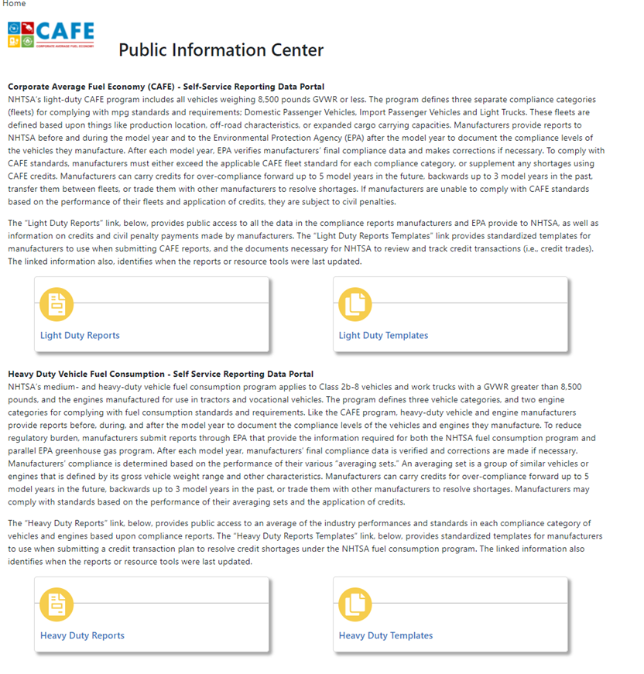
Homepage-Overview
The Public Information Center (PIC) is NHTSA’s information site and the authoritative source for Corporate Average Fuel Economy (CAFE) and Medium- and Heavy-Duty (MDHD) Fuel Efficiency program data.
Information Includes:
CAFE/MDHD Program Overview
LD PIC Reports
  Currently includes up to MY 2017 Data and LD Templates downloading resources
MDHD static PIC report and templates resources
Reports can be viewed online, downloaded as EXCEL or PDF

Slide 33
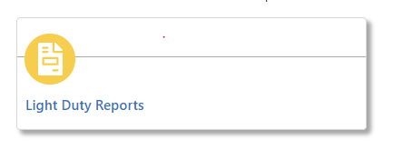
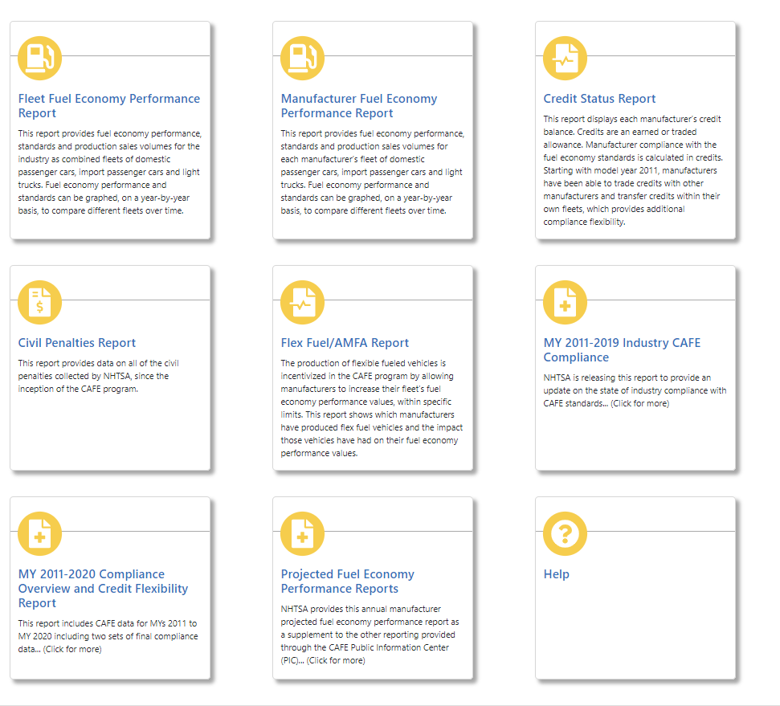
LD PIC reports
Reports and Links include:
Fleet Fuel Economy Performance Report
Manufacturer Fuel Economy Performance Report
Credit Status Report
Civil Penalties Report
Flex Fuel/AMFA Report
Additional Static Reports
Help Page

Slide 34
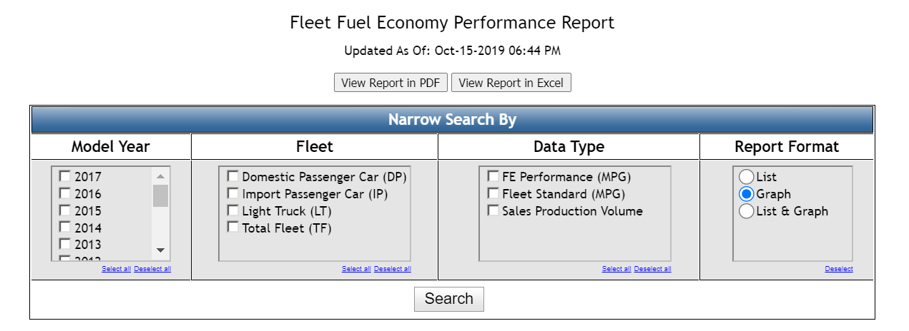
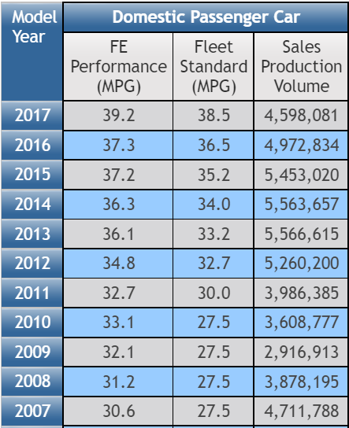
LD PIC reports-
Fleet Fuel Economy Performance Report
Data level: industry as combined fleets (DP/IP/LT)
Data Includes:
  fuel economy performance/standards
  production sales volumes
Fuel economy performance and standards can be graphed

Slide 35
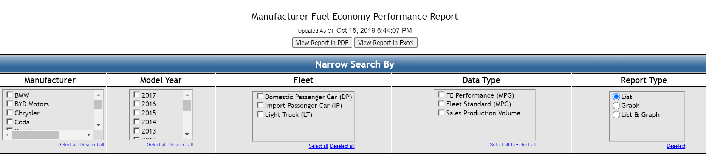
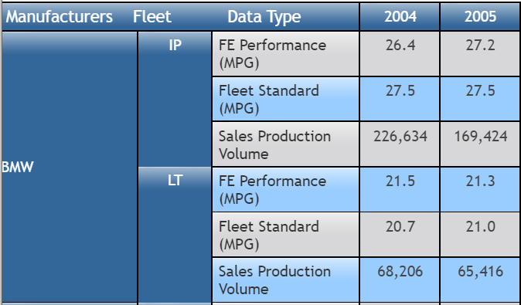
LD PIC reports-
Manufacturer Fuel Economy Performance Report
Data level: each manufacturer’s fleet of DP/IP/LT
Data Includes:
  fuel economy performance/standards
  production sales volumes
Fuel economy performance and standards can be graphed

Slide 36
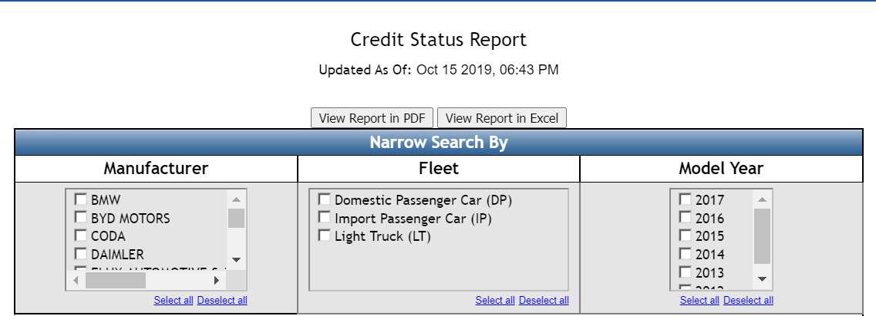
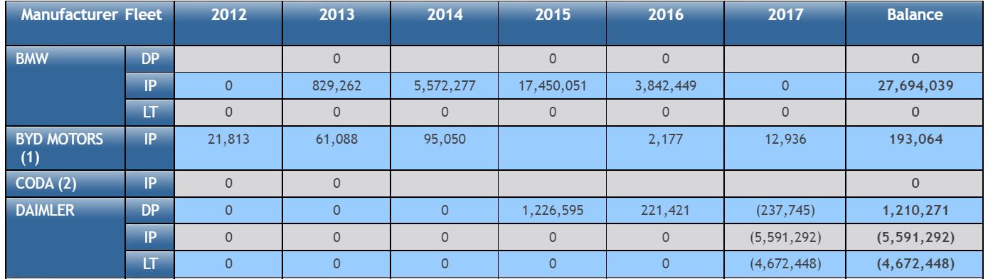
LD PIC reports-
Credit Status Report
Data level: each manufacturer’s fleet of DP/IP/LT
Data Includes:
Credit balances for each year starting with model year 2011
Overall Credit Balance
Updated annually
  Currently, only updated through 2017
  Pending until EPA finals are available.

Slide 37
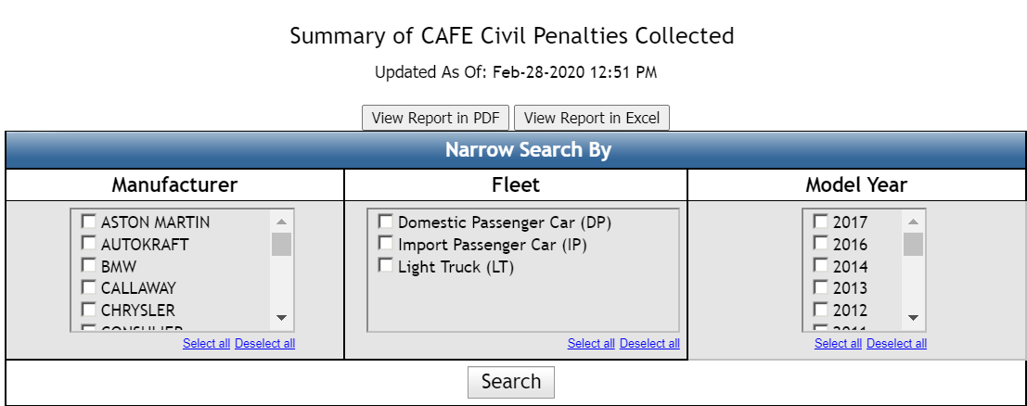
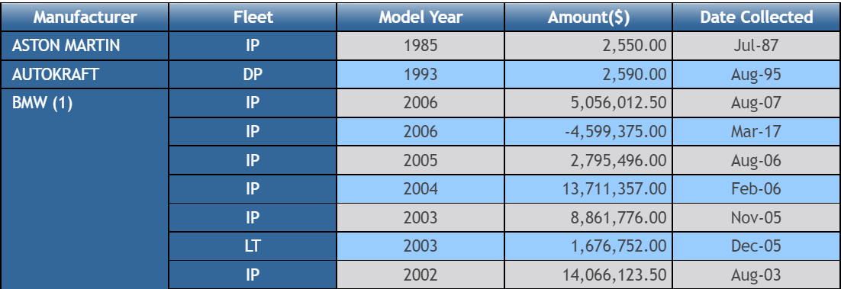
LD PIC reports-
Civil Penalties Report
Data Includes:
All the civil penalties collected by NHTSA since the inception of the CAFE program.

Slide 38
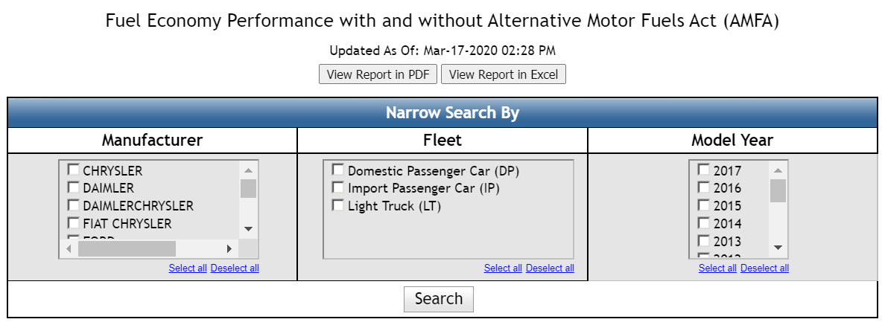
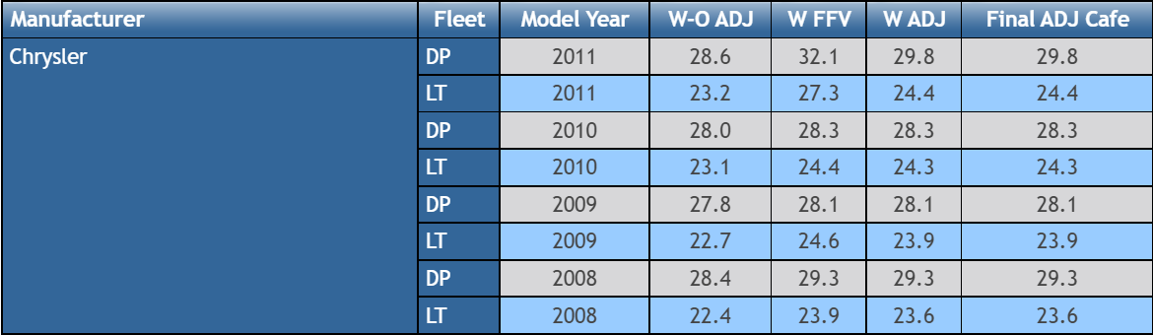
LD PIC reports-
Flex Fuel/AMFA Report
Alternative Motor Fuels Act (AMFA): was established in 1988 by Congress as an incentive based program for vehicle manufacturers complying with the CAFE program for the production of motor vehicles capable of operating on certain alternative fuels.
Data level: each manufacturer’s fleet of DP/IP/LT
Data Includes:
The impact of flex fuel vehicles (FFV) and AMFA on performance values
AMFA ended in 2019.

Slide 39
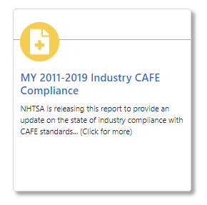
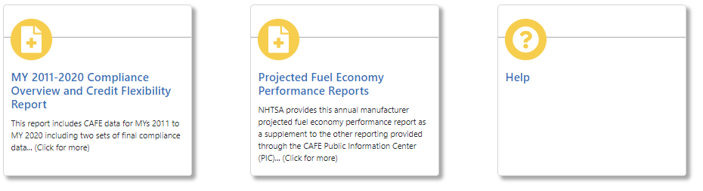
LD PIC reports-
Additional Reports
Static Reports:
Projected Fuel Economy Performance Reports:
  supplement to the other reporting
  contains pre- and mid-model year which has not been verified by NHTSA or EPA (Finals can be different)
MY 2011-2019 Industry CAFE Compliance
  update on the state of industry compliance with CAFE standards.
  Includes credit shortfalls and credit balances for MY 2011 to 2019.
Help Page
  Technical Support- how to view the reports in excel in windows/Mac iOS

Slide 40
LD Templates
Credit Template Resources for downloading:
NHTSA CAFE Projections Reporting Template
NHTSA CAFE Credit Transaction Template
NHTSA CAFE Credit Value Template

Slide 41
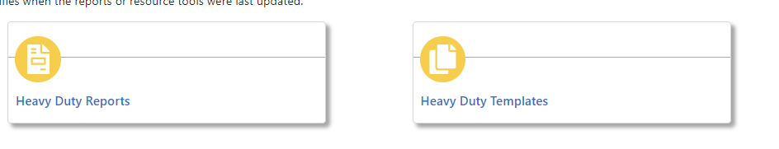
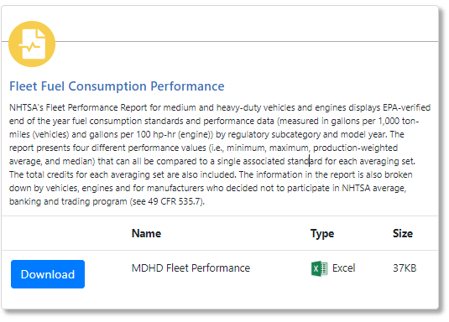
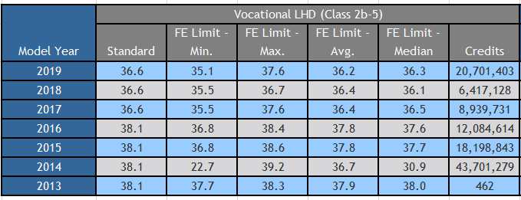
MDHD reports-
Manufacturer Fuel Economy Performance Report
Static Report:
Data level: industry as combined fleets (by regulatory subcategory)
Data Includes:
  performance/standards
  Credit status by average set/regulatory subcategory (per 49 CFR 535)

Slide 42
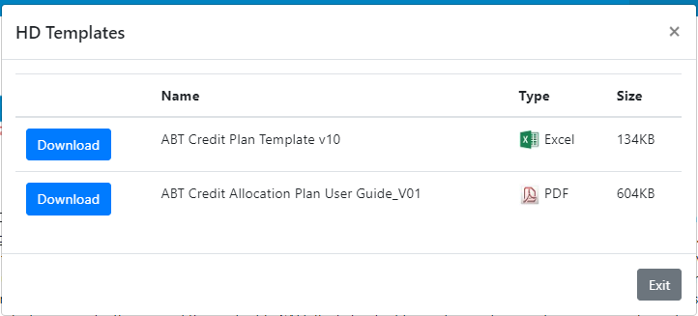
MDHD reports-
Credit Allocation Template

Slide 43
Credit Value Reporting Template
07.12. 2022

Slide 44
1
Background
AGENDA
2
Purpose of the Template
07.12.2022
3
Overview of the Template
4
Demonstration

Slide 45
Background
#
NHTSA adopted requirements in the 2020 Final Rule requiring manufacturers to submit the costs of all credit trade contracts to the agency, enforcement will begin September 1, 2022
  49 CFR 536.5(c)(5) Starting in model year 2021, manufacturers or credit holders issuing credit instructions or providing credit allocation plans as specified in § 536.5(d), must use the NHTSA Credit Template fillable form (OMB Control No. 2127-0019, NHTSA Form 1475). The NHTSA Credit Template is available for download on NHTSA's website. If a credit instruction includes a trade, the NHTSA Credit Template must be signed by managers legally authorized to obligate the sale and/or purchase of the traded credits from both parties to the trade. The NHTSA Credit Template signed by both parties to the trade serves as an acknowledgement that the parties have agreed to trade credits, and does not dictate terms, conditions, or other business obligations of the parties. All parties trading credits must also provide NHTSA the price paid for the credits including a description of any other monetary or non-monetary terms affecting the price of the traded credits, such as any technology exchanged or shared for the credits, any other non-monetary payment for the credits, or any other agreements related to the trade. Manufacturers must submit this information to NHTSA in a PDF document along with the Credit Template through the CAFE email, cafe@dot.gov. NHTSA reserves the right to request additional information from the parties regarding the terms of the trade.
Manufacturers were concerned that they didn’t understand what needed to be reported as part of the non-monetary cost of credit trades
To assist manufacturers in submitting the required information, NHTSA has developed an optional Credit Value Template
  The Template was originally proposed as required in the most recent NPRM
  Upon receipt of comments the template was changed to optional in the Final Rule

Slide 46
#
Monetary Value of Traded Credits
CAFE penalty rate sets the maximum value of a traded credit
Dollar value related to the CAFE fine rate
    Up to MY 2018 = $5.50 per 1/10th mpg
    MY 2019-2021 = $14 per 1/10th mpg
    MY 2022 = $15 per 1/10th mpg
    Rates continue to increase in accordance with 28 USC 2461
NHTSA will study influencing factors
    Credit life
    Originating fleet
    Part 536 Adjustment Factors

Slide 47
#
Non-monetary Value of Traded Credits
Several non-monetary factors found to impact the price of credit trades
An exchange for credits
An exchange for intellectual property
An exchange for technology
An exchange for goods and services
An exchange for corporate control
Other factors
The template will be modified and improved as we receive information from manufacturers

Slide 48
#
Template Instructions
Credit Buyers may fill out the Credit Value Reporting Template every time they complete a trade (49 FR 536.5) or they may report credit cost information using another format
                Credit Buyers must submit the Credit Transaction Template and cost information for each transaction
      Credit Buyers will use the Unique ID from Credit Transaction Template for both templates

Slide 49
#
Overview
When: Credit Buyers will be required to submit cost information for credit transactions
Location: https://one.nhtsa.gov/cafe_pic/AdditionalInfo.htm
      For More Information:
                Federal Register :: Corporate Average Fuel Economy Standards for Model Years 2024-2026 Passenger Cars and Light Trucks
                Section: VII. B. 4.

Slide 50

#
Demonstration
how to fill out the credit value reporting template

Slide 51
CAFE Compliance 101
Office of Vehicle Safety Compliance (OVSC) Fuel Efficiency Group
07.12.2022

Slide 52

In 1978, the Energy Policy and Conservation Act (EPCA) established the CAFE Program, 49 USC 329:
  Flat CAFE standards with periodic increases for the first several model years
    Separate standards for domestic passenger cars, import passenger cars, and light trucks, with compliance separately for each
  Roles for both NHTSA and EPA
    NHTSA establishes the CAFE standards and administers the CAFE program
    EPA validates manufacturers’ final compliance values and provides them to NHTSA as a basis for NHTSA enforcement
  Credit program established for manufacturers
    Earned credits could be carried forward/backwards to resolve a current MY deficit
In 2007, the Energy Independence and Security Act (EISA) amended EPCA:
  Passenger car and light truck standards to be based on footprint beginning in 2011
  Separate minimum standard for domestic passenger cars
  Introduced credit trades and transfers, and extended carry-forward period from 3 to 5 years
Relevant History

Slide 53
49 CFR 523 - Vehicle Classification
49 CFR 525 - Exemptions from CAFE Standards [for Low-Volume Mfrs]
49 CFR 531 - Passenger Car CAFE Standards
49 CFR 533 - Light Truck CAFE Standards
49 CFR 534 - Rights and Responsibilities of Manufacturers in the Context of Changes in Corporate Relationships
49 CFR 536 - Transfer and Trading of Fuel Economy Credits
49 CFR 537 - Fuel Economy Reports
49 CFR 538 - Manufacturing Incentives for Alternative Fuel Vehicles
49 CFR 575.401 - Fuel Economy Labeling
CAFE Regulations
Congress established 49 USC 329 and NHTSA established several CAFE regulations in response
To find the text of these regulations please see: https://www.ecfr.gov/

Slide 54

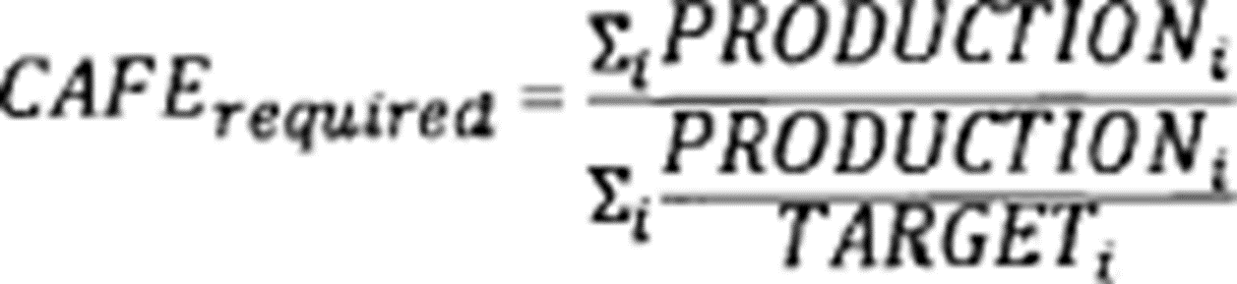
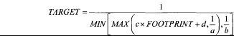

Minimum Domestic Passenger
Car Standards
#
Current Footprint Based Standards
Model year | Minimum standard
2011 | 27.8
2012 | 30.7
2013 | 31.4
2014 | 32.1
2015 | 33.3
2016 | 34.7
2017 | 36.8
2018 | 38.1
2019 | 39.6
2020 | 41.1
2021 | 39.9
2022 | 40.6
2023 | 41.1
2024 | 41.8
2025 | 42.4
2026 | 43.1
Passenger Cars
Light Trucks
- TARGET is the fuel economy target (in mpg) applicable to vehicles of a given footprint (FOOTPRINT, in square feet);
Parameters a, b, c, and d for passenger cars are defined in Table III of 49 CFR Part 531
Parameters a, b, c, d, e, f, g and h for light trucks are defined in Table VII of 49 CFR Part 533
- The MIN and MAX functions take the minimum and maximum, respectively, of the included values.

Slide 55
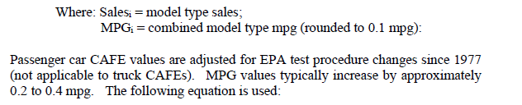
Current CAFE Performance
#
(Measurements confirmed by EPA, using DOE-established PEF as applicable)
*Electric Vehicles are dedicated Alternative Fuel Vehicles and CAFE values are determined in accordance with 40 CFR part 600, Sub-part F.

Slide 56
Petition for Alternative Standards
Low volume manufacturers (< 10,000 vehicles globally) unable to achieve CAFE standards may petition for lower standards
Petitions must be submitted 24 months before the MY begins
Petition must include:
          Total number of passenger cars manufactured
          Data and information from 49 CFR 525.7, and the calculations used to develop that data
    Discussion of alternative and additional means considered in order to be within standards
    Calculation of an average fuel economy figure for the OEMs fleet
(2 YRs before MY)
Per 49 CFR 525

Slide 57
Pre-Cert and Required Reporting (Up to 2YRs before MY)
Compliance Testing
(During MY)
Final Compliance
(After MY)
#
OEMs seek guidance from EPA and submit approvals for technologies, exemptions, exclusions and requests for AC and off-cycle incentives (copies must be sent to NHTSA by OEM).
OEMs/EPA pre-application process; defines test groups and other planned testing for determining standards and performance values. EPA provides oversight for certification testing –CERTIFICATE OF CONFORMITY
OEMs gain access to EPA database and EPA assists with uploading certification data.
If necessary, OEMs submit petitions for Alternative Standards to NHTSA
OEMs supply information to NHTSA if selected for Part 537 Footprint Compliance program, usually by September before MY
OEMs submits to NHTSA CAFE pre-model year (PMY) reports by December 31st before the MY
OEMs submit final compliance data to EPA database on March 31
EPA evaluates final data
EPA submit final verified data to OEMs and NHTSA
NHTSA issues official credits balance and shortfall compliance letters and takes any enforcement action
OEMs submit credit allocation plans or pay fines if credit shortfalls exists
OEMs submit to NHTSA any credit transactions
EPA and NHTSA issue public reporting
OEMs can continue to submit supporting documents for AC and off-cycle incentives (copies must be sent to NHTSA by OEM).
OEMs conducts validation testing on remaining model types
OEMs submits CAFE mid-model year (MMY) reports to NHTSA by July 31st
OEMs submit any supplemental CAFE Reports to NHTSA (as necessary)
OEMs submit to NHTSA any CAFE credit transactions

Slide 58
Part 537 Footprint Compliance Test Program
(Aug-Sept before MY)
#
NHTSA selects 5-15 vehicles for validation testing to evaluate manufacturer compliance with footprint measurement regulations
Vehicles tested at San Angelo Test Facility (STF) in TX.
CAFE Standards calculated from footprint values; the product of vehicle track widths and wheelbase measurements
A test failure occurs when measured values (+ tolerances) < manufacturers’ reported values
When there is a non-conformance:
  Contact OEM and validate non-conformance
  If non-conformance substantiates an error; manufacturer must correct numbers to testing values
  NHTSA shares all numbers with EPA
Manufacturers may report smaller values including safety margins with no penalty
Wheelbase
Footprint
Track Width
Track Width
Wheelbase

Slide 59
#
Compliance Timeline
REPORT | Dec 20XX | Jan 20YY | Feb 20YY | Mar 20YY | Apr 20YY | May 20YY | Jun 20YY | Jul 20YY | Aug 20YY | Sep 20YY | Oct 20YY | Nov 20YY | Dec 20YY | Jan 20ZZ | Feb 20ZZ | Mar 20ZZ | Apr 20ZZ | May 20ZZ | Jun 20ZZ | Jul 20ZZ | Aug 20ZZ | Sep 20ZZ | Oct 20ZZ | Nov 20ZZ | Dec 20ZZ
Pre-Model Year Reports (Dec 31, 20XX) Send Reminder Letters Collect Reports Enforce Timely, Complete Submissions
Mid-Model Year Reports (Jul 31, 20YY Send Reminder Letters Collect Reports Enforce Timely, Complete Submissions
OEM Final Reports (Mar 31, 20ZZ) Send Reminder Letters Collect Reports Enforce Timely, Complete Submissions
EPA Final Reports (Oct-Dec 20ZZ) Collect Reports Process Data and Determine any Shortfalls Compliance

Slide 60
#
Annual CAFE Compliance Reports
Pre-Model Year (PMY) Reports - Due to NHTSA by Dec 31 before the MY
Includes projected data for domestic & import passenger cars and light trucks
  Model type build characteristics, production, and estimated CAFE values
  Average fleet fuel economy values
Mid-Model Year (MMY) Reports - Due to NHTSA by July 31 of the MY
Must include same information as PMY reports
MMY reports include a combination of actual & projected information available by June of the MY
BOTH REPORTS
OEMs submit confidential reports (to NHTSA’s Chief Counsel’s OFC) and redacted reports (to cafe@dot.gov)
See COVID guidance at: https://www.nhtsa.gov/coronavirus/submission-confidential-business-information
Supplemental reports due 30-days after changes are known
OEMs must submit timely CAFE reports or be subject to civil penalties (49 USC 32912(a))
Starting MY 2023, OEMs must use a new standardized reporting template

Slide 61
#
OEM and EPA Final Reports
Usually March-August After the Model Year
OEM CAFE Final Model Year (FMY) Reports
  Provided in accordance with EPA requirements in 40 CFR 600.512-12
  Due to EPA by March 31st after the MY
  Includes OEM’s final reported data for model types and fleets
  NHTSA must receive copies from OEMs (at cafe@dot.gov)
  EPA Final Verified Reports
  EPA verifies approx. 5% of each manufacturer’s final data
  EPA sends the data electronically through a web exchange to NHTSA’s CAFE database, usually by October after the MY
  This is the data that NHTSA uses for compliance

Slide 62
#
NHTSA Final Compliance
Usually August-December After the Model Year
NHTSA uses EPA verified finals to establish OEMs’ final CAFE compliance values
OEMs with CAFE performance values exceeding CAFE standards earn credit surpluses
OEMs with CAFE performance values falling below CAFE standards have credit deficits
NHTSA sends enforcement letters to OEMs
  Credit Balance Letters: Sent to all OEMs to establish official CAFE credit account balances
  Credit Shortfall Letters: Sent to manufacturers who have a shortfall requiring a credit allocation plan or payments of civil penalties within 60 days

Slide 63
#
Credit Transactions
  Carry-forward/-back:
    Credits carried forward/backward from MY within the same compliance category
    Credits can be carried forward from 5 previous years or back from 3 future years
  Transfer: Credits transferred from other compliance fleets within the same manufacturer (i.e., Domestic passenger vehicles to light truck), using an adjustment factor
  Trade: Credits can be acquired by trading with another manufacturer, also using an adjustment factor
  Paying Civil Penalties: fine rate x each 0.1 mpg shortage x Fleet PRD Volume
Credit Deficits can be Resolved Through the Following Methods:

Slide 64
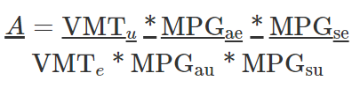
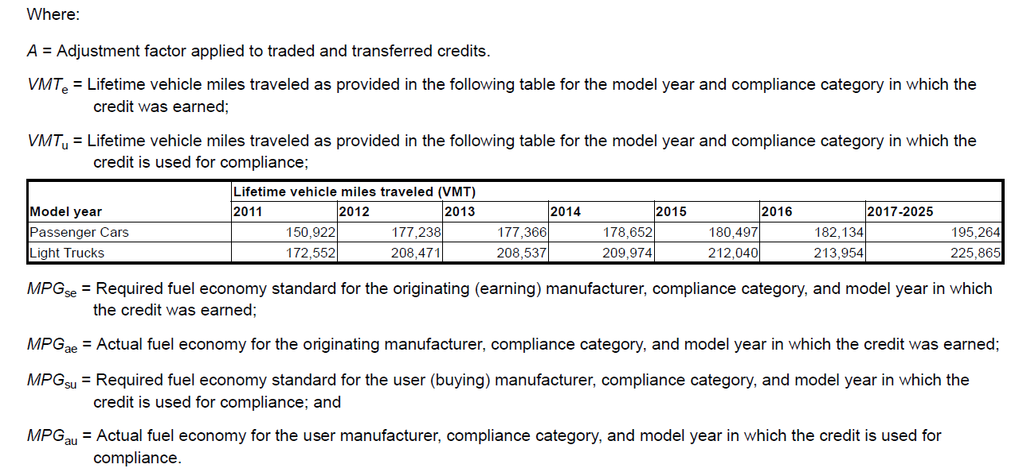
Credit Transaction Calculations
#
Adjustment Factor Calculation
A credit is earned for every 1/10 mpg above or below the standard for every vehicle the manufacturer produces in a compliance fleet.
Adjustment Factor: traded or transferred credits must be adjusted to preserve fuel savings. Adjustment factor is the factor used to adjust the value of a traded or transferred credit for compliance purposes to ensure that the compliance value of the credit when used reflects the total volume of oil saved when the credit was earned. (See 49 CFR 536)

Slide 65
Minimum standard for domestic PC compliance category (49 U.S.C. § 32902 (b)(4))
  Manufacturers who fail to meet the minimum standard may carry forward or backwards within their domestic PC fleet, but otherwise must settle their shortfall through civil penalties
  Can’t trade or transfer credits from other fleets
Credit transfer limitations (49 U.S.C. § 32903 (g)(3))
  MY 2011 - 2013, 1.0 mpg; MY 2014 - 2017, 1.5 mpg; MY 2018 and thereafter, 2.0 mpg
  Applies to transferring credits from all fleets
Credit banking
  Credit banking is not allowed with credits earned in a different compliance fleet
Limitations on Use of Credits

Slide 66
#
Approval of Credit Transactions
As part of NHTSA’s database; NHTSA keeps track of each manufacturer’s credit balance
If a manufacturer wishes to trade or transfer credits, they request a credit transaction from OVSC (Office of Vehicle Safety Compliance)
  A template is available on the PIC site for creating a credit transaction request
  Template will be required beginning in September 2022
Credit transaction requests are received and reviewed
  NHTSA checks that credits are available
  NHTSA checks that adjustment factor and calculations are correct
After credit transactions are approved, they are uploaded into the database

Slide 67
AC, Off-Cycle (OC) Incentives
The emissions/fuel consumption benefits allowed for AC and OC technologies are determined from:
  Menu Items
    AC technologies which improve AC leakage (EPA only) and efficiency (EPA & NHTSA) – see 40 CFR 86.1868-12 (EPA) and 49 CFR 531.6/533.6 (NHTSA)
    OC technologies: Waste Heat Recovery; High Efficiency Lighting; Solar Panels; Active Aerodynamic Improvement; Engine Idle Start-Stop; Active Warmup; and Thermal Control Technologies - see 40 CFR 86.1869-12 (EPA) and 49 CFR 531.6/533.6 (NHTSA)
  5-cycle testing
  Proven through testing
Benefits used to generate GHG emission credits for EPA and increases in CAFE performance for NHTSA
OEMs can gain benefits for technologies whose benefits are not shown in the standard 2-cycle test

Slide 68
  NHTSA does not need to be consulted for menu technologies
  For non-menu items NHTSA and EPA will consult to determine if the technology qualifies. The evaluation will consider:
    Whether the technology has a direct impact upon improving fuel economy performance;
    Whether the technology is related to crash-avoidance technologies, safety critical systems or systems affecting safety-critical functions, or technologies designed for the purpose of reducing the frequency of vehicle crashes;
    Information from any assessments conducted by the EPA related to the application, the technology and/or related technologies; and
    Any other relevant factors.
NHTSA OC Approvals

Slide 69

End of Workshop – Thank you for attending
#
Additional Materials
PIC SITE
Templates- see “Light Duty Templates”
Slides and Q&A document- will be on the PIC shortly
NHTSA plans to release an unlocked version of its PMY template on the CAFE PIC site.
NHTSA will issue an enforcement reminder to manufacturers for the 2022 CAFE MMY Report
For Further Questions
  By email - cafe@dot.gov.
  Phone: Maurice Hicks (202)366-5289 or Chris Lamance (202)366-9525
  Interested party can request to meet with NHTSA. Send meeting requests to cafe@dot.gov.

Slide 70
When do the new CAFE reporting requirements take effect?
  September 1, 2022 – NHTSA will enforce 49 CFR 536.5(c)(5) Credit Trade Cost Information, required on January 1, 2021
All parties trading credits must also provide NHTSA the price paid for the credits including a description of any other monetary or non-monetary terms affecting the price of the traded credits, such as any technology exchanged or shared in exchange for the credits, any other non-monetary payment for the credits, or any other agreements related to the trade.
  September 1, 2022 - Credit Transactions per Template https://one.nhtsa.gov/cafe_pic/assets/Downloads/Light-Duty/NHTSA%20CAFE%20Credit%20Transaction%20Template_v23.xlsm
  December 31, 2022 – MY 2023 PMY Reports per Template
https://one.nhtsa.gov/cafe_pic/assets/Downloads/Light-Duty/NHTSA%20CAFE%20Projections%20Reporting%20Template_v225_CONFIDENTIAL.xlsm
  March 31, 2023 - MY 2022 Model year report per 40 CFR 600.512-12
The results of the manufacturer calculations and summary information of model type fuel economy values which are contained in the average fuel economy calculation shall also be submitted to the Secretary of the Department of Transportation, National Highway and Traffic Safety Administration.
  January 1, 2024 – Eligibility for NHTSA Off-cycle Approvals
    (Existing) Copies of all documents sent to EPA at the same time
    (New) Copies of MY 2024+ Off-cycle analytical plans must be approved by EPA before the MY. (see 40 CFR 86.1869-12)
    (New) Copies of MY 2024+ Off-cycle official credit applications approved by EPA by September of MY. (see 40 CFR 86.1869-12)
    (New) Extension approved by NHTSA 30-days before deadlines

